Slide 1


Slide 2
Marketing Challenge
Magnolia Coffee Company

Slide 3
Company Profile:
Magnolia Coffee Company
Company Background
The Magnolia Coffee Company was founded in 2009 in Summerville, South Carolina when owner Dan Sumner went looking for a local neighborhood place to meet with friends and clients that was warm, welcoming, and inviting. After years of traveling and working abroad, Dan settled down outside of Charleston with his dog Buddy. Bringing his interest in international, fair trade coffees, he purchased and outfitted his first coffee shop out of what would be the first of over 200 local neighborhood retail locations across the Southeast United States.
Located in suburbs outside of major metropolitan areas with populations of 50-75k people, each Magnolia Coffee Company location is known for its local hometown flavor and community ties. Retail locations are situated near heavily populated office buildings, high traffic retail shopping and eating establishments and next to gym and fitness studios.
Marketing has been more of a buckshot approach without consistent or strategic actions. Dan started building his marketing efforts by marketing to everyone who enjoys coffee. He also created a website, a Facebook page, and even an online app to assist with online ordering and a frequent customer rewards program. While word-of-mouth and some social media posts have gained a dedicated and loyal following, the last two years have seen stagnant growth. Dan is looking for a marketing plan that will help build his customer base and his bottom line.

Slide 4
Competitor Profile: ClamClams
Company Background
Magnolia’s biggest competitor is Clamclams - a massive multinational chain of 10,000+ coffeehouse stores in the US alone. It’s known for its wide variety of hot and cold drinks, as well as its selection of pastries, sandwiches, and other foods. Their revenue is almost exclusively derived from physical store sales.
Clamclams branding strategy highlights its commitment to sourcing high-quality coffee beans, as well as its efforts to promote sustainability and social responsibility. The company is known for its seasonal in-out drinks, like the “Cherry Blossom Latte” - its yearly releases have turned into anticipated events that are happily shared on social media among the brand's core users.
Despite its triumphs, ClamClams has experienced a variety of challenges. The company was late to identify the demand for the rise of delivery services for ordering beverages without visiting a physical store. So far, ClamClams failed to figure out an efficient way to use 3rd party delivery providers without a huge impact on gross margins or prices.
Furthermore, Clamclams is heavily dependent on a limited number of suppliers who are able to satisfy its ever-growing demands without compromising quality. Also, like any big brand, Clamclams is under constant scrutiny in the public eye. Every claim made by the company is verified. In a few instances, the company faced the threat of a nationwide boycott when its fair-trade image was put in doubt.

Slide 5
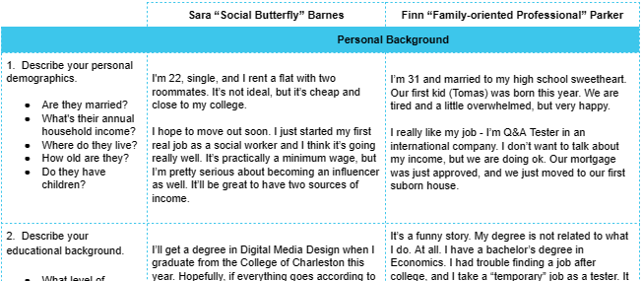
Magnolia Coffee Company
As a marketer, you will want to conduct the interviews to understand the product/service you will be marketing. We provided interviews conducted with two typical Magnolia’s customers to help you identify the target audience better.
Click here to access the full interviews.

Slide 6
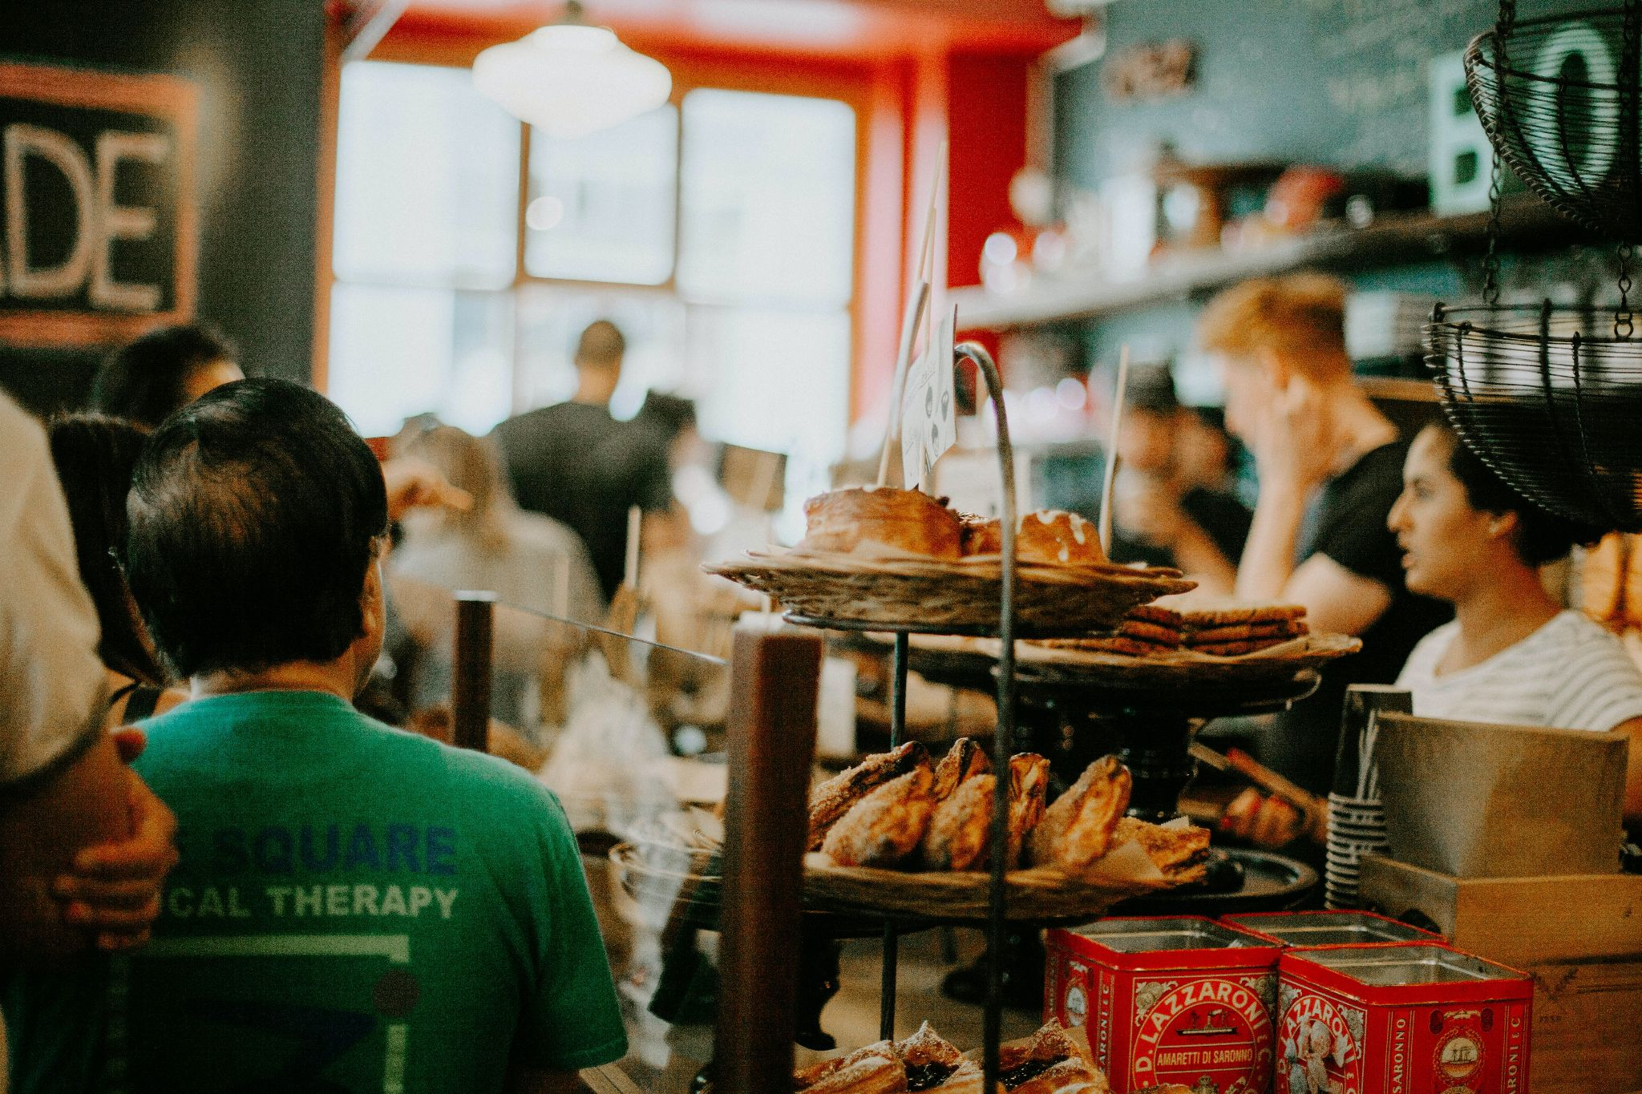
Magnolia Coffee Company
You are tasked with creating a marketing plan for the Magnolia Coffee Company. More specifically, your objective is to provide the following:
Target Market
SMART Marketing Objectives and associated KPI
Competitor’s S.W.O.T.
Magnolia’s S.W.O.T
Value Proposition
Empathy Map
Customer Persona
Customer Journey Map
Customer Friction
Marketing Plan [Optional]
For the purpose of the projects, assume retail beverage products and costs are the same for Magnolia Coffee Company as it is with any competitors.

Slide 7
Step 1:
Market Position

Slide 8
Identifying the Target Market
A college is nearby, so there are plenty of college students living at home nearby or renting apartments in the suburban area. Since they’re college students, many of them are working part time and have a limited income. There are other middle class families in the area as well, including some who are new to the area with kids and demanding jobs.

Slide 9
SMART Marketing Objective
for Magnolia Coffee Company
Over the next 12 months, Magnolia Coffee Company will target busy college students and families as the consumer market, which will increase sales by 10%.

Slide 10
Key Performance Indicator
for Magnolia Coffee Company
The goal is to increase sales by $1000 per week.

Slide 11
SWOT Analysis Competitor for ClamClams
Knowing the ClamClam’s Strengths and Opportunities, please provide at least two Weaknesses and at least two Threats.
Strengths
Weaknesses
Strong brand recognition
Wide range of products
Large global presence
Under constant scrutiny by the public
Understaffed
Opportunities
Threats
Expansion to (yet) untapped markets
Diversification to non-coffee products
Cross-marketing with other global brands
Rising costs and recession
New and changing government regulations

Slide 12
SWOT Analysis
for Magnolia Coffee Company
Knowing the Magnolia Coffee Company Weaknesses and Threats, please provide at least two Strengths and Opportunities.
Strengths
Weaknesses
Can foster more member relationships
A more efficient supply chain
Limited resources
Not established brand image
Quality of service vary depending on staff in given location
Opportunities
Threats
Creating a dedicated brand image
The ability to create a talented and skilled team through training
Competitors with bigger marketing budget
Increasing costs of obtaining new customers
Differences between locations can create inconsistent brand image

Slide 13
Value Proposition
Write a value proposition using Geoffrey Moore’s template for Magnolia Coffee Company :
For busy students and families who need convenient coffee, our coffee is delicious and affordable. Unlike ClamClams, Magnolia Coffee Company gives excellent coffee and food while offering small town service. .
.

Slide 14
Step 2:
Customer Persona

Slide 15




Empathy Map
Based on the provided interviews, please fill in the Empathy Map below. Each quadrant of the empathy map should have at least three points. Feel free to adjust the design or formatting to suit your needs.
Thinking
Seeing
Focused on education
Thinking about where their career is going
Thinking about their influencer goals
Watch and listen to content on Youtube
Attends live music shows with friends
Follows travel social media accounts
Doing
Feeling
Posting on Instagram often
College classes
Trying to make time with friends
Tired
Excited for the future
Busy with education
Hopeful about influencing and traveling

Slide 16
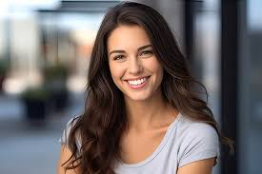
Customer Persona
Joanna Cohen
Background and Demographics | Joanna Cohen | Needs
Single woman 22 years old College Student Rents flat with roommates Junior Social Worker |  | Affordable food and beverages Convenient, close to the college
Hobbies or Interests (At least 2 points) | Goals (At least 2 points) | Barriers (At least 2 points)
Social Media Traveling Music Being with friends | Obtain a degree in Digital Media Design Become an influencer Travel the world | Income level Student debt

Slide 17
Step 3:
Customer Journey Map

Slide 18

Customer Journey: Introduction
As you know, the customer journey is how marketers explain the process a potential customer goes through to become an actual customer of your business and this helps a marketer decide when to talk to the customer. We’ve used the AIDA framework to Map customers experiences and corresponding frictions at each stage of the journey:

Slide 19
Customer Journey Map
 | Awareness | Interest | Action
Goal: Broad objective for this stage | Create awareness about Magnolia Coffee company | Inform about our location and what food and beverages we offer | To draw the customer into one of our coffeeshops
TouchPoint (doing): Where is the customer and how can they interact with the brand | At this stage, the potential customer needs to be reached. We can interact online while they browse Social Media or selected websites. | The customer is either at school or at home, scrolling through Instagram. | The customer comes in with friends for the live music event.
Experience (Thoughts/Feelings): Happy? Stressed? Describe the state of mind of your customer during interactions with the brand. | We aim to reach them when they are relaxed but open to new experiences, like when they're casually browsing the internet. | The customer was relaxed and unrushed, and became interested in our post about a live music event we’re having this Saturday. | She enjoyed her time with us so much that she talked to her friends about meeting up for coffee the next morning.

Slide 20
Customer Friction
For this slide please assume that Magnolia’s Customer Rewards Program is performing below expectations.
What steps can be taken to remedy potential friction identified below?
 | Post-Action
Potential Gap: What’s point of friction was identified? | Magnolia Coffee aims to acquire more users in its rewards program during the Post-action phase of the customer's journey. However, a potential point of friction may occur with this initiative due to privacy concerns. It seems that customers could be hesitant to provide their personal data for marketing purposes.
Solution: What milestone or step can be added to remedy this? | To ease customer concerns about personal data, we can just take their first name or even a nickname and a phone number. Or offer a rewards card that they get stamped so they don’t have to provide any information.

